Slide 1

Quantum Computing
Quantum computing represents a new era in computation, leveraging the principles of quantum mechanics to solve problems beyond the capabilities of classical computers.
Quantum computing is a groundbreaking form of computing that uses quantum bits, or qubits, to process information
T.Bhavana Sri
(22071A67C3)

Slide 2

What is Quantum Computing?
1
Harnessing Quantum Phenomena
2
Qubits
Quantum computers use qubits, which can represent both 0 and 1 simultaneously, unlike classical bits that can only represent one or the other.
Quantum computing utilizes the principles of superposition and entanglement to perform computations in a fundamentally different way than classical computers.
3
Quantum Algorithms
Specialized algorithms are developed to take advantage of the unique capabilities of quantum computers.

Slide 3
The Quantum Advantage
Exponential Speedup
New Possibilities
Quantum computers can solve certain problems exponentially faster than classical computers, particularly in areas like optimization and cryptography.
Quantum computers open doors to solving complex problems that are currently intractable for classical computers, such as drug discovery and materials science.

Slide 4


Qubits and Quantum States
Superposition
Entanglement
Qubits can exist in a superposition of states, meaning they can be both 0 and 1 simultaneously, unlike classical bits.
Entangled qubits are interconnected, even when physically separated, and their fates are intertwined, allowing for powerful correlations.
Tunneling
Particles can pass through seemingly impenetrable barriers, a phenomenon not possible in classical physics.

Slide 5
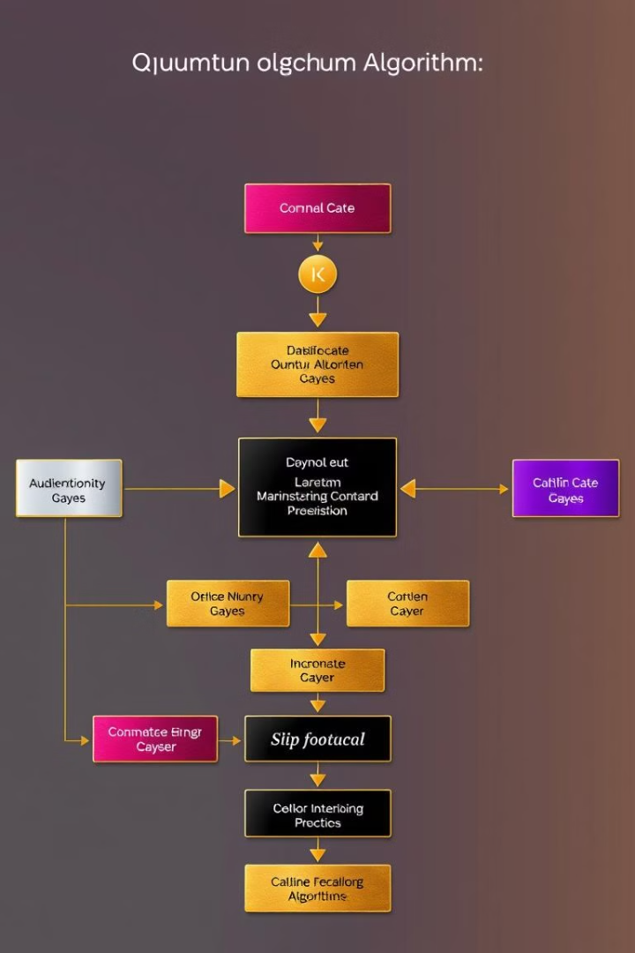
Quantum Algorithms and Problem-Solving
1
Shor's Algorithm
A revolutionary algorithm that efficiently factors large numbers, posing a threat to current encryption methods.
2
Grover's Algorithm
A search algorithm that can find a specific item in an unsorted database much faster than classical algorithms.
3
Quantum Simulation
Quantum computers can simulate complex quantum systems, enabling breakthroughs in materials science, drug discovery, and other fields.

Slide 6



Quantum Cryptography and Security
Quantum Key Distribution
Quantum cryptography uses the principles of quantum mechanics to generate secure keys for communication, making it impossible for eavesdroppers to intercept them.
Post-Quantum Cryptography
Researchers are developing new cryptographic algorithms that are resistant to attacks from quantum computers, ensuring future cybersecurity.

Slide 7

Challenges and Limitations of Quantum Computing
Decoherence
Qubits are extremely sensitive to environmental noise, which can cause them to lose their quantum properties.
Scalability
Building large, stable quantum computers with a large number of qubits remains a significant engineering challenge.
Error Correction
Quantum computers are prone to errors, and developing effective error correction methods is crucial for reliable computation.

Slide 8
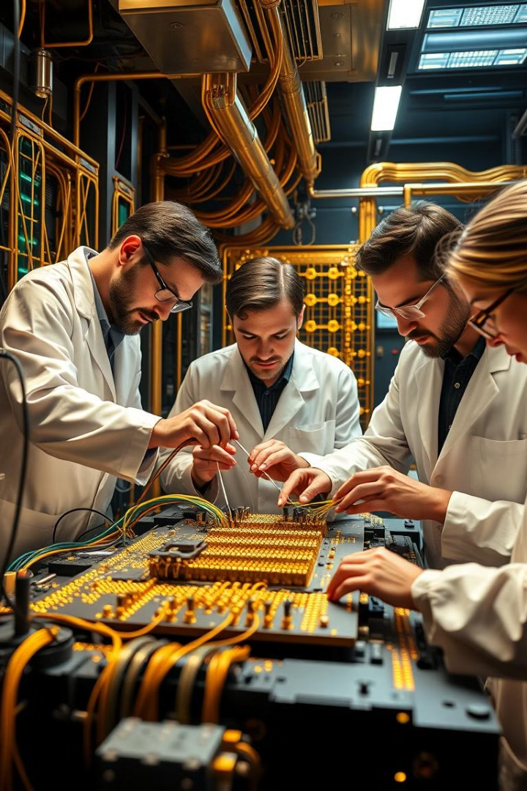



Current Developments and Breakthroughs
Hardware Advancements
Significant progress has been made in developing more stable and scalable quantum computing hardware, including superconducting qubits and trapped ions.
Algorithm Development
New quantum algorithms are being developed for specific applications, including drug discovery, materials science, and artificial intelligence.
Cloud-Based Access
Quantum computers are becoming more accessible through cloud platforms, allowing researchers and businesses to experiment with the technology.

Slide 9

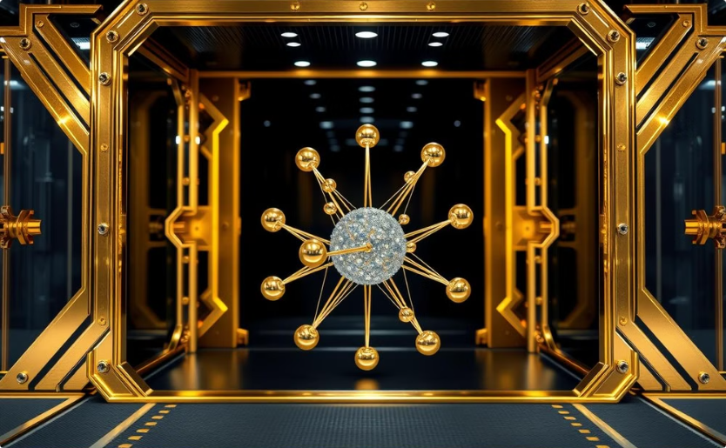
The Potential Impact of Quantum Computing
Drug Discovery
Materials Science
Quantum computers can accelerate drug discovery by simulating complex molecular interactions and identifying promising drug candidates.
Quantum computers can simulate the behavior of materials at the atomic level, leading to the development of new materials with superior properties.

Slide 10

The Future of Quantum Computing: Predictions and Outlook
Quantum computing is still in its early stages of development, but it has the potential to revolutionize numerous fields, from medicine and materials science to finance and artificial intelligence.

Slide 11


